Slide 1
Predictive Analysis of Crime Data in Calgary Using Neural Networks
Irfan Ahmed
MSDS-15-2024

Slide 2
Problem Statement
The City of Calgary experiences monthly fluctuations in crime rates, impacting public safety and resource allocation. This project aims to analyze historical crime data from 2018 to 2024 to uncover trends and patterns. Leveraging a neural network model, we seek to accurately predict future crime occurrences, enabling proactive decision-making and enhanced urban planning.

Slide 3
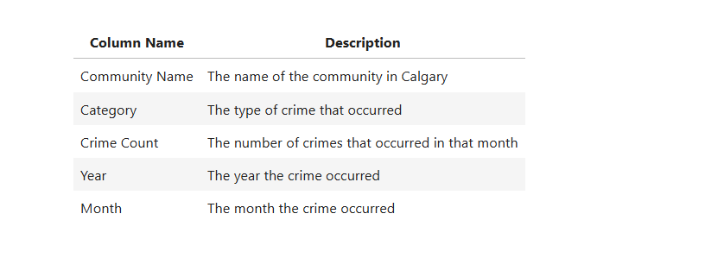
Data column

Slide 4
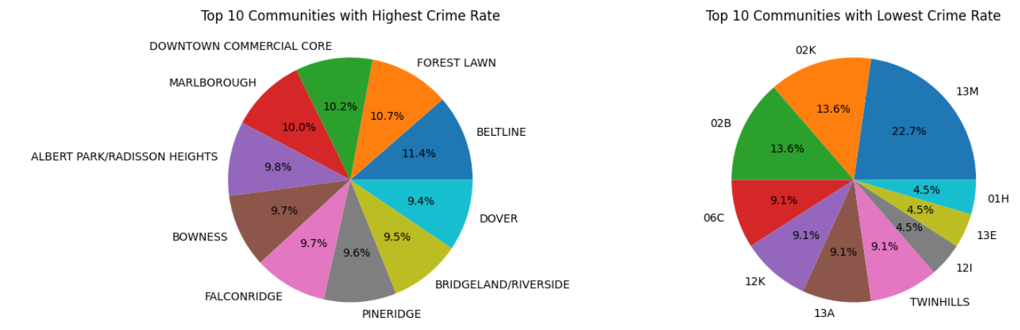
EDA

Slide 5
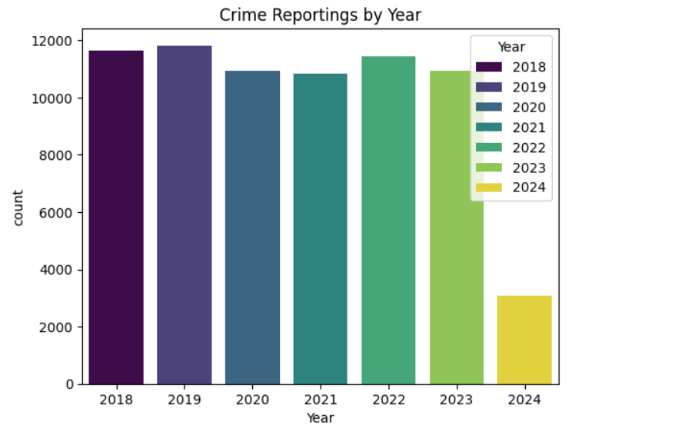
EDA

Slide 6
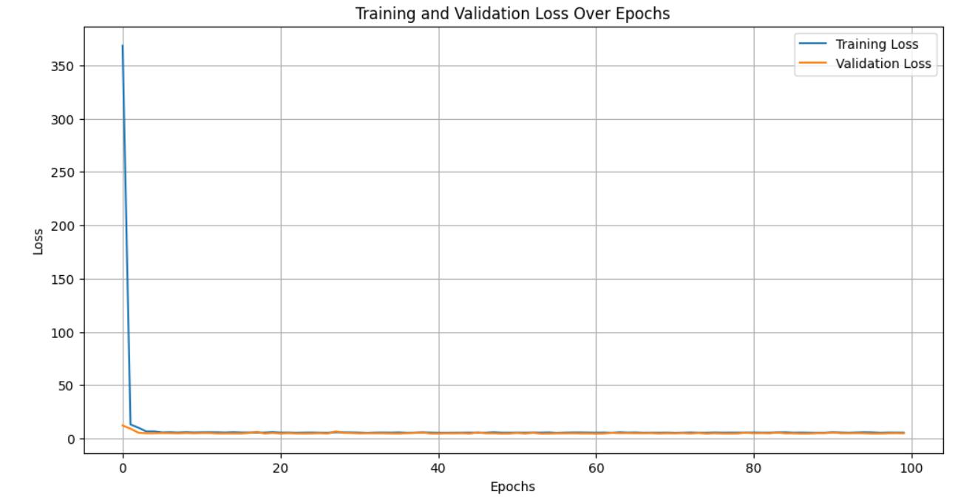
Model Training Graph

Slide 7
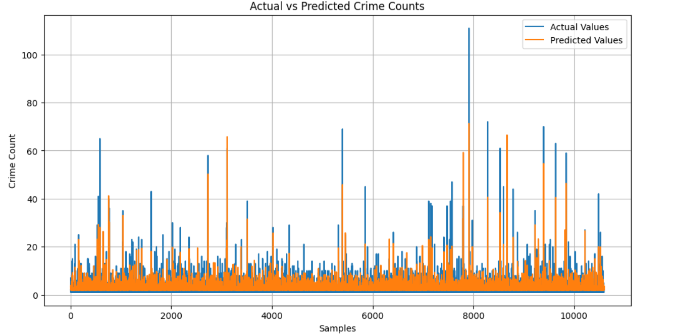
Predication

